Slide 1


Neural Models for Information Retrieval
Bhaskar Mitra
Principal Applied Scientist
Microsoft AI and Research
Research Student
Dept. of Computer Science
University College London
November, 2017

Slide 2
This talk is based on work done in collaboration with
Nick Craswell, Fernando Diaz, Emine Yilmaz, Rich Caruana, Eric Nalisnick, Hamed Zamani, Christophe Van Gysel, Nicola Cancedda, Matteo Venanzi, Saurabh Tiwary, Xia Song, Laura Dietz, Federico Nanni, Matt Magnusson, Roy Rosemarin, Grzegorz Kukla, Piotr Grudzien, and many others

Slide 3
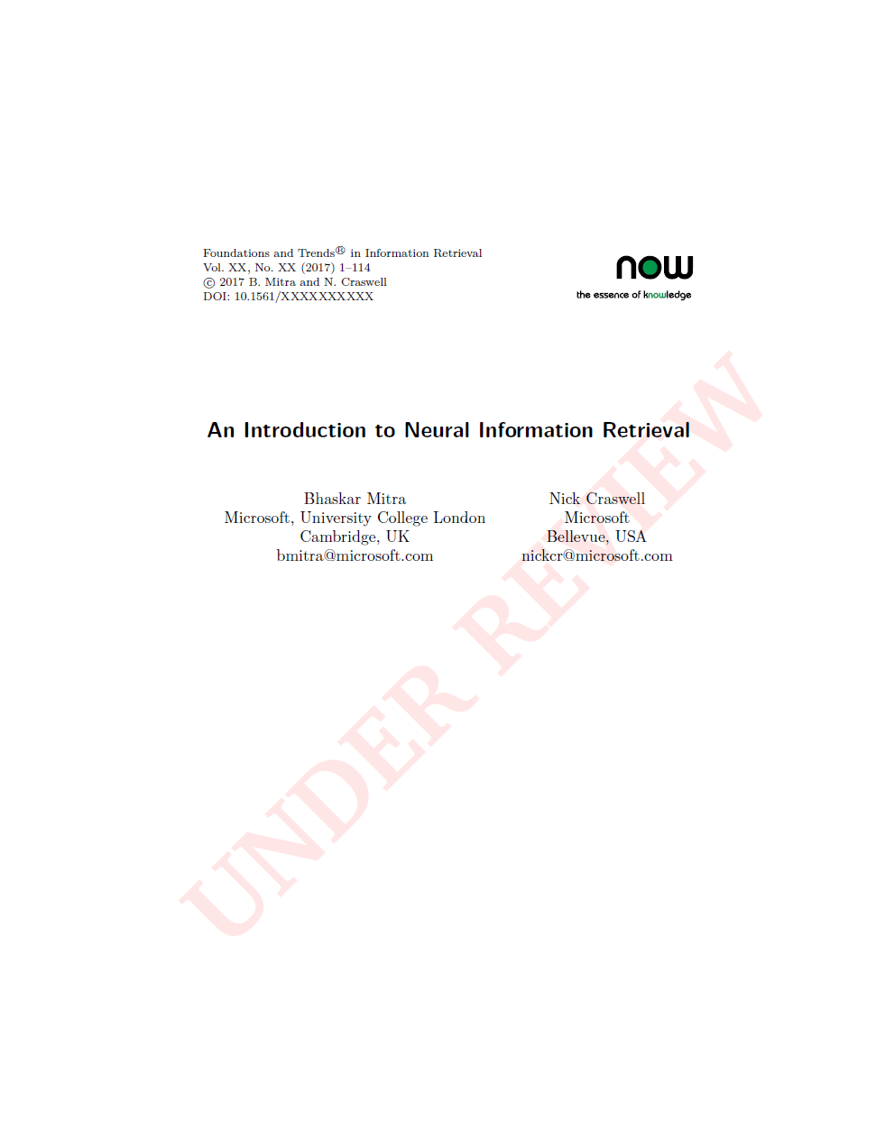
For a general overview of neural IR refer to the manuscript under review for
Foundations and Trends® in Information Retrieval
Pre-print is available for free download
http://bit.ly/neuralir-intro
Final manuscript may contain additional content and changes
Or check out the presentations from these recent tutorials,
WSDM 2017 tutorial: http://bit.ly/NeuIRTutorial-WSDM2017
SIGIR 2017 tutorial: http://nn4ir.com/

Slide 4
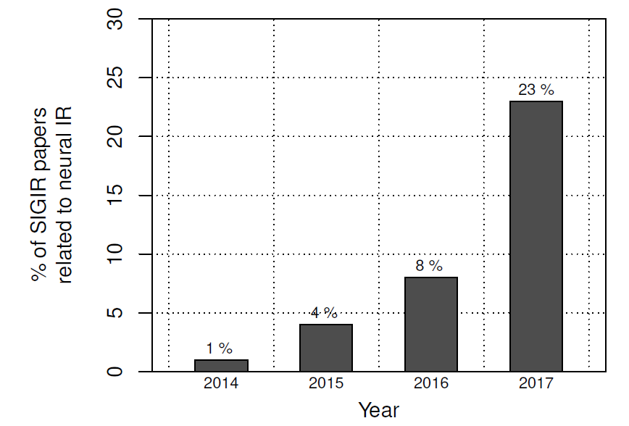
Neural Networks
Amazingly successful on many difficult application areas
Dominating multiple fields:
Each application is different, motivates new innovations in machine learning
2011 | 2013 | 2015 | 2017
speech | vision | NLP | IR?
Source: (Mitra and Craswell, 2018)
https://www.microsoft.com/en-us/research/...
Our research:
Novel representation learning methods and neural architectures motivated by specific needs and challenges of IR tasks

Slide 5
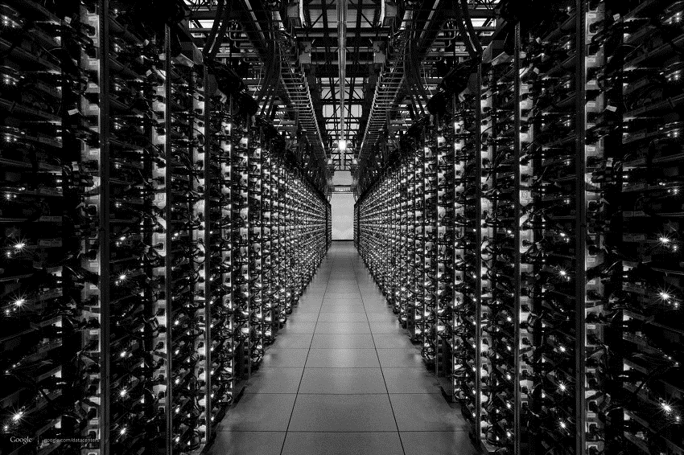


IR task may refer to Document ranking
Information need
query
Relevance
(documents satisfy information need e.g. useful)
retrieval system indexes a document corpus
results ranking (document list)

Slide 6
But it may also refer to…
Query auto-completion
Next Query suggestion
cheap flights from london t|
cheap flights from london to miami
cheap flights from london to frankfurt
cheap flights from london to new york
cheap flights from london to miami
cheap flights from london to sydney
Related searches
package deals to miami
ba flights to miami
things to do in miami
miami tourist attractions

Slide 7
Anatomy of an IR model
IR in three simple steps:
Generate input (query or prefix) representation
Generate candidate (document or suffix or query) representation
Estimate relevance based on input and candidate representations
Neural networks can be useful for one or more of these steps
estimate relevance
point of match
input
vector
candidate
vector
generate input representation
generate candidate representation
point of input representation
point of candidate representation
input text
candidate text

Slide 8
Neural networks can help with…
Learning a matching function on top of traditional feature based representation of query and document
But it can also help with learning good representations of text to deal with vocabulary mismatch
In this part of the talk, we focus on learning good vector representations of text for retrieval
neural network model for matching
generate manually designed features
input text
candidate text

Slide 9
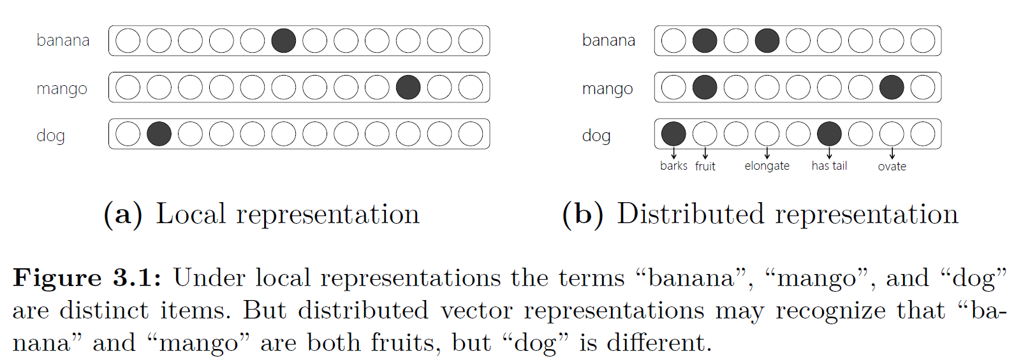
A quick refresher on vector Space representations
Under local representation the terms banana, mango, and dog are distinct items
But distributed representation (e.g., project items to a feature space) may recognize that banana and mango are both fruits, but dog is different
Important note: the choice of features defines what items are similar

Slide 10
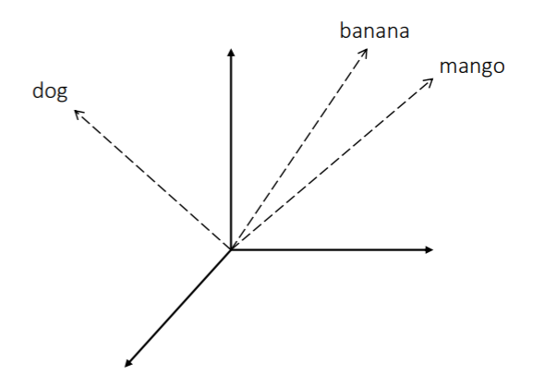
A quick refresher on vector Space representations
An embedding is a new (latent) space such that the properties of, and the relationships between, the items are preserved
Compared to original feature space an embedding space may have one or more of the following:
Less number of dimensions
Less sparseness
Disentangled principle components

Slide 11
Notions of similarity
Is “Seattle” more similar to…
“Sydney” (similar type)
Or
“Seahawks” (similar topic)
Depends on what feature space you choose

Slide 12
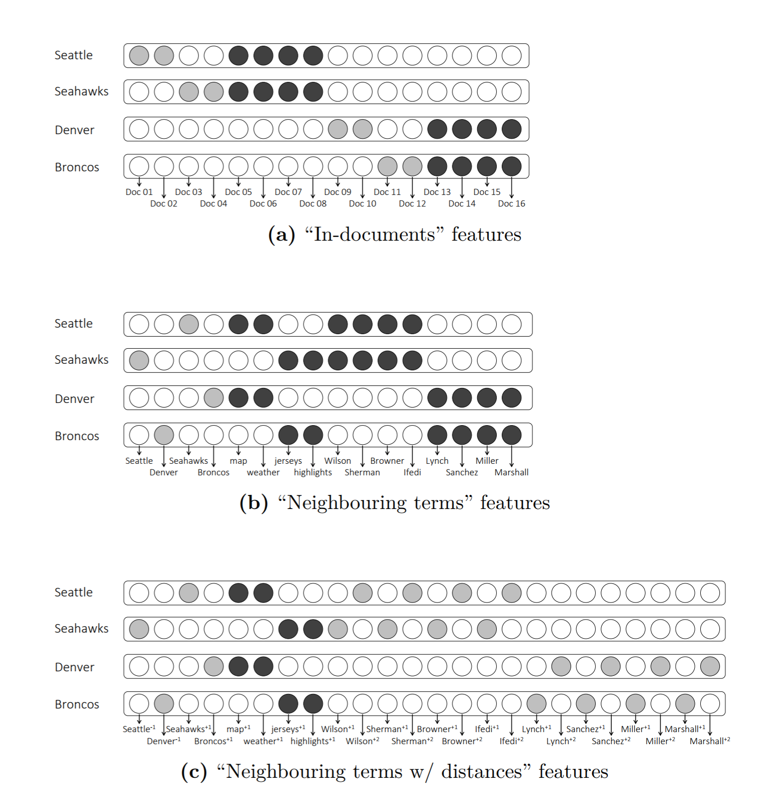
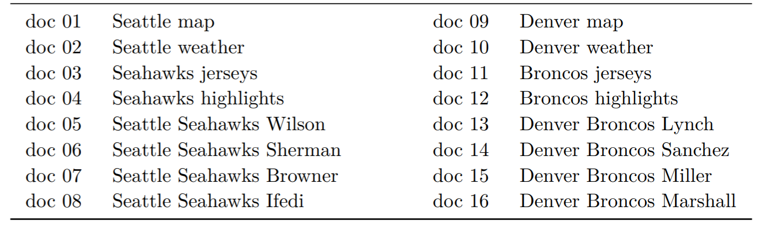
Notions of similarity
Consider the following toy corpus…
Now consider the different vector representations of terms you can derive from this corpus and how the items that are similar differ in these vector spaces

Slide 13
Notions of similarity

Slide 14
Notions of similarity

Slide 15
Notions of similarity

Slide 16
Notions of similarity
Consider the following toy corpus…
Now consider the different vector representations of terms you can derive from this corpus and how the items that are similar differ in these vector spaces

Slide 17
Retrieval using embeddings
Given an input the retrieval model predicts a point in the embedding space
Items close to this point in the embedding space are retrieved as results
Relevant items should be similar to /near each other in the embedding space

Slide 18
So the desired notion of similarity should depend on the target task
Document ranking
Query auto-completion
Next query suggestion
cheap flights to london
cheap flights to |
cheap flights to london
✓ cheap flights to london
✗ cheap flights to sydney
✗ hotels in london
✓ cheap flights to london
✓ cheap flights to sydney
✗ cheap flights to big ben
✓ budget flights to london
✓ hotels in london
✗ cheap flights to sydney
Next, we take a sample model and show how the same model captures different notions of similarity based on the data it is trained on

Slide 19
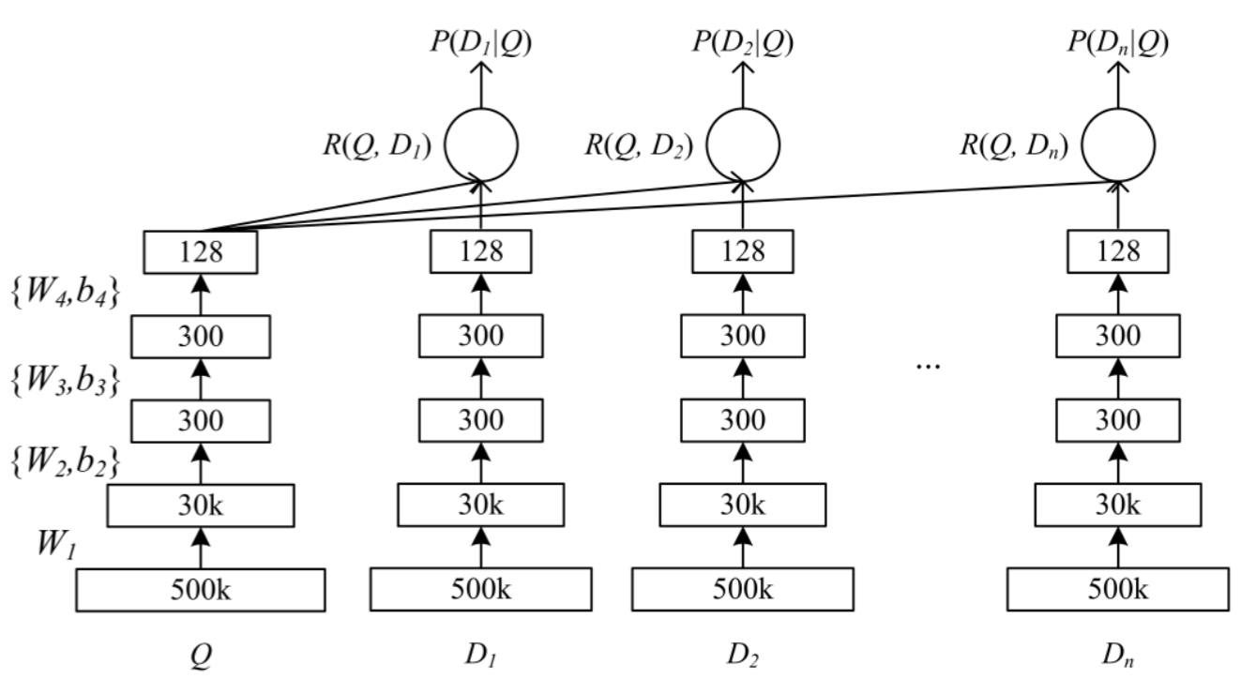
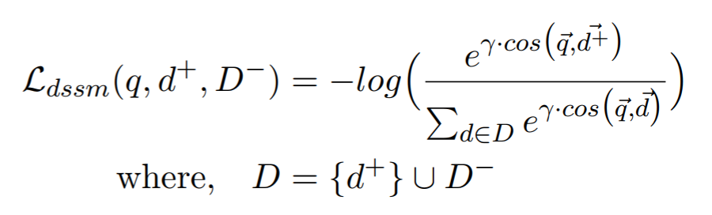
Deep semantic similarity model (dssm)
Siamese network with two deep sub-models
Projects input and candidate texts into embedding space
Trained by maximizing cosine similarity between correct input-output pairs
(Huang et al., 2013)
https://dl.acm.org/citation...

Slide 20
DSSM trained on different types of data
Trained on pairs of… | Sample training data | Useful for | Paper
Query and document titles | <“things to do in seattle”, “seattle tourist attractions”> | Document ranking | (Shen et al., 2014) https://dl.acm.org/citation...
Query prefix and suffix | <“things to do in”, “seattle”> | Query auto-completion | (Mitra and Craswell, 2015) https://dl.acm.org/citation...
Consecutive queries in user sessions | <“things to do in seattle”, “space needle”> | Next query suggestion | (Mitra, 2015) https://dl.acm.org/citation...
Each model captures a different notion of similarity / regularity in the learnt embedding space

Slide 21
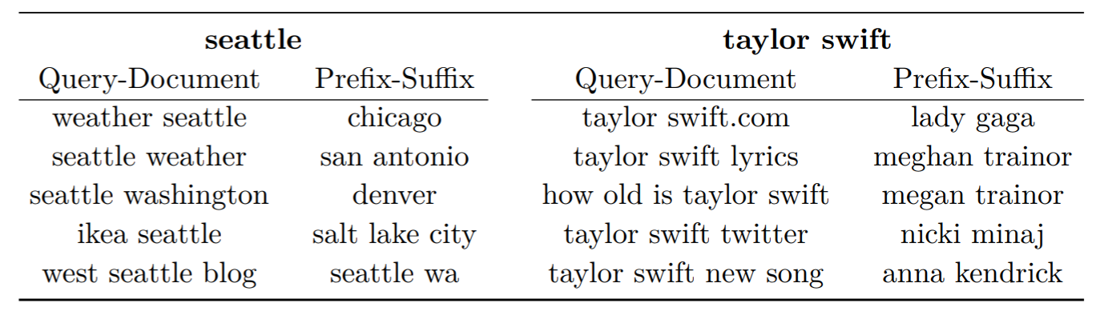
Different regularities in different embedding spaces
Nearest neighbors for “seattle” and “taylor swift” based on two DSSM models – one trained on query-document pairs and the other trained on query prefix-suffix pairs

Slide 22
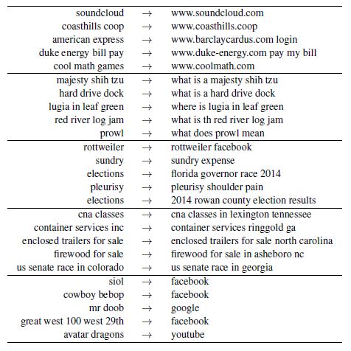
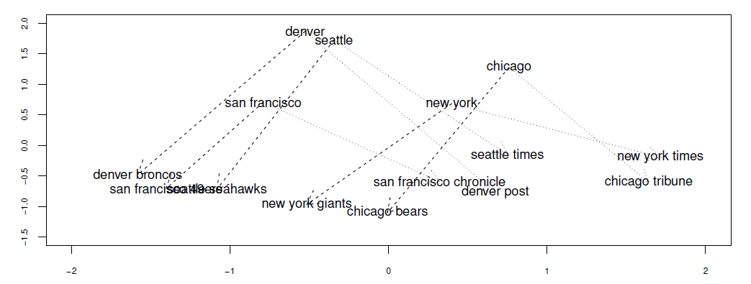
Different regularities in different embedding spaces
Groups of similar search intent transitions from a query log
The DSSM trained on session query pairs can capture regularities in the query space (similar to word2vec for terms)

Slide 23
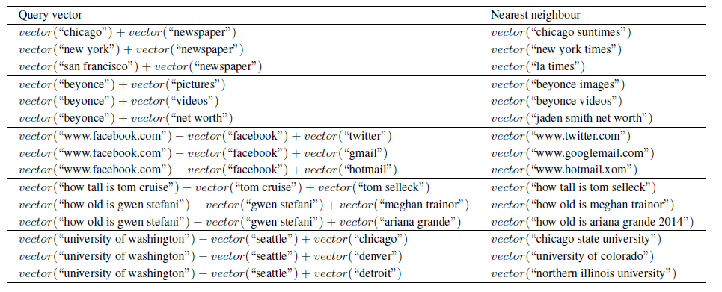
DSSM trained on Session query pairs Allows for analogies over short text!

Slide 24
When is it particularly important to think about notions of similarity?
If you are using pre-trained embeddings, instead of learning the text representations in an end-to-end model for the target task

Slide 25
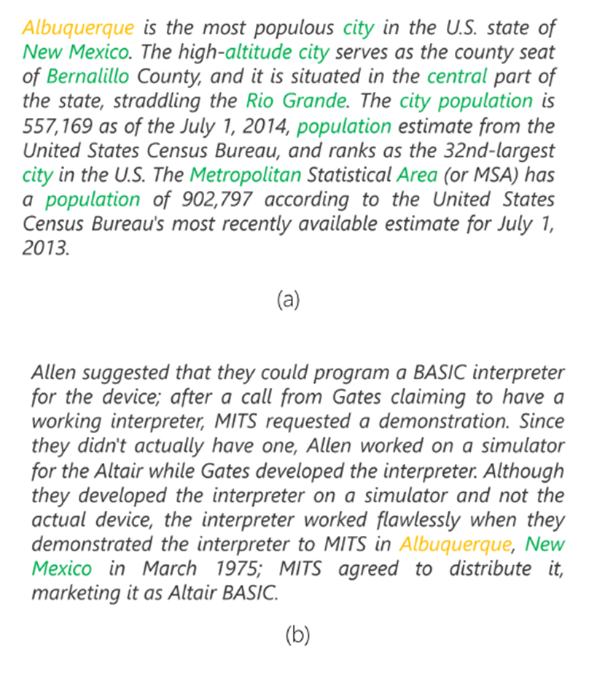
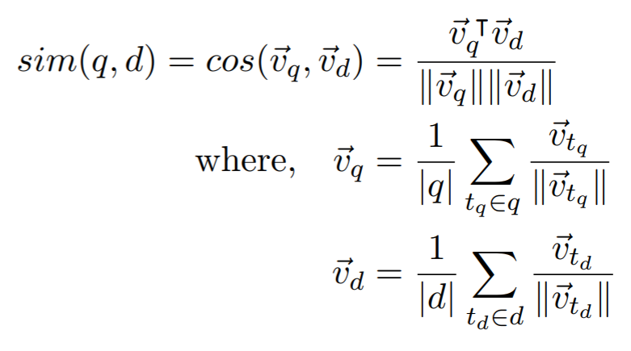
Using pre-trained word embeddings for document ranking
Non-matching terms “population” and “area” indicate first passage is more relevant to the query “Albuquerque”
Use word2vec embeddings to compare every query and document terms
Passage about Albuquerque
Passage not about Albuquerque

Slide 26
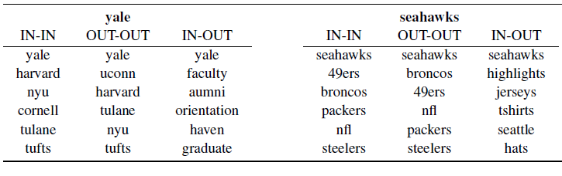
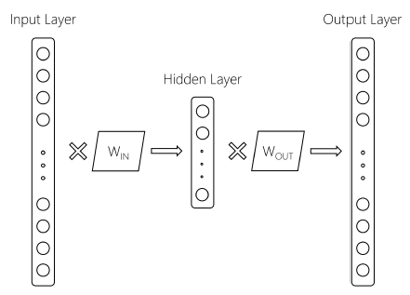
Dual embedding space model (DESM)
IN-OUT similarity captures a more Topical notion of term-term relationship compared to IN-IN and OUT-OUT
Better to represent query terms using IN embeddings and document terms using OUT embeddings
…but what if I told you that everyone using word2vec is throwing half the model away?
(Mitra et al., 2016)
https://arxiv.org/abs/1602.01137

Slide 27
Get the data
Download
IN+OUT Embeddings for 2.7M words trained on 600M+ Bing queries
https://www.microsoft.com/en-us/download/details.aspx?id=52597

Slide 28



But terms are inherently ambiguous
or

Slide 29
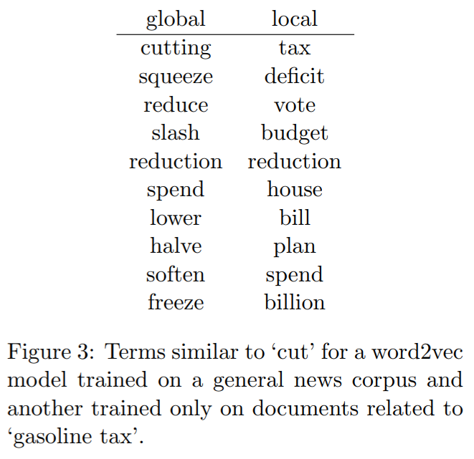
topic-specific term representations
Terms can take different meanings in different context – global representations likely to be coarse and inappropriate under certain topics
Global model likely to focus more on learning accurate representations of popular terms
Often impractical to train on full corpus – without topic specific sampling important training instances may be ignored

Slide 30
Topic-specific term embeddings for query expansion
query
corpus
cut gasoline tax
results
Use documents from first round of retrieval to learn a query-specific embedding space
Use learnt embeddings to find related terms for query expansion for second round of retrieval
topic-specific term embeddings
cut gasoline tax deficit budget
(Diaz et al., 2015)
http://anthology.aclweb.org/...
expanded query
final results

Slide 31
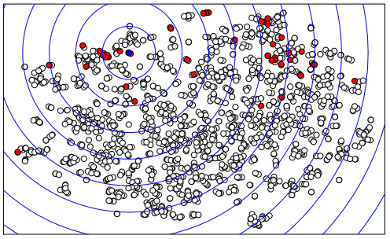
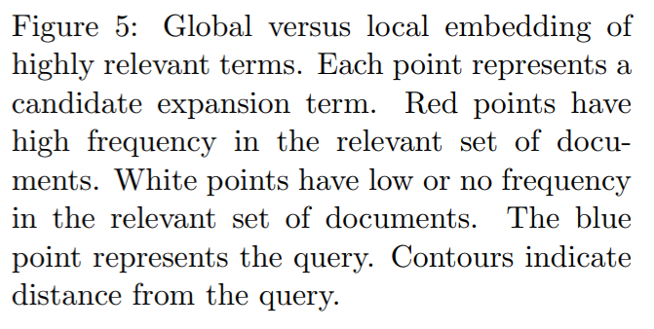
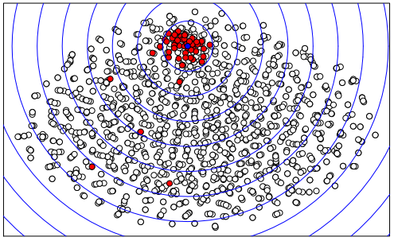
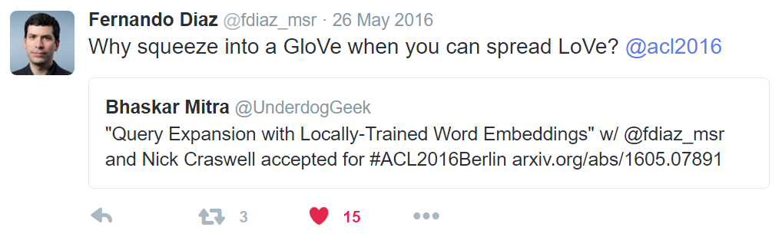
global
local

Slide 32
Now, let’s talk about deep neural network models for document ranking…

Slide 33
Challenges in short vs. long text retrieval
Short-text
Vocabulary mismatch more serious problem
Long-text
Documents contain mixture of many topics
Matches in different parts of a long document contribute unequally
Term proximity is an important consideration

Slide 34
A tale of two queries
“pekarovic land company”
“what channel seahawks on today”
Hard to learn good representation for rare term pekarovic
But easy to estimate relevance based on patterns of exact matches
Proposal: Learn a neural model to estimate relevance from patterns of exact matches
Target document likely contains ESPN or sky sports instead of channel
An embedding model can associate ESPN in document to channel in query
Proposal: Learn embeddings of text and match query with document in the embedding space
The Duet Architecture
Use neural networks to model both functions and learn their parameters jointly

Slide 35
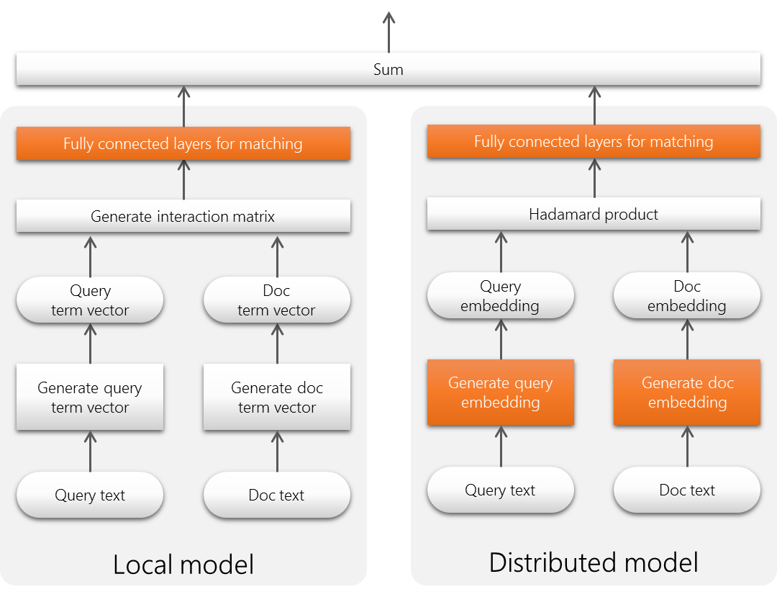
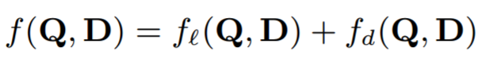
The Duet architecture
Linear combination of two models trained jointly on labelled query-document pairs
Local model operates on lexical interaction matrix, and Distributed model projects text into an embedding space for matching
(Mitra et al., 2017)
https://dl.acm.org/citation...
(Nanni et al., 2017)
https://dl.acm.org/citation...

Slide 36
Local sub-model
Focuses on patterns of exact matches of query terms in document

Slide 37
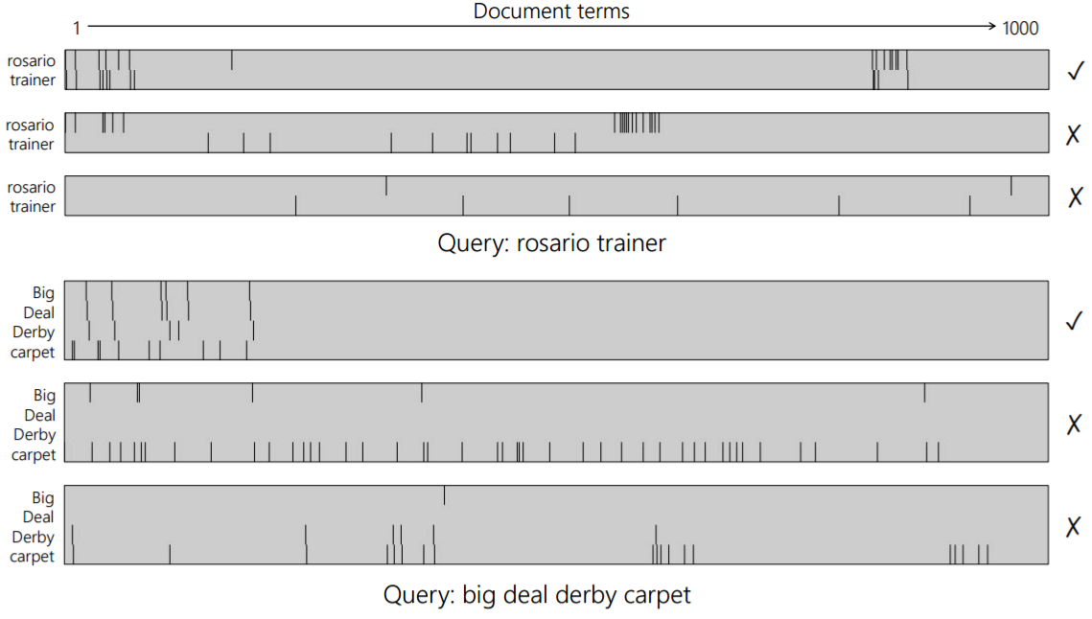
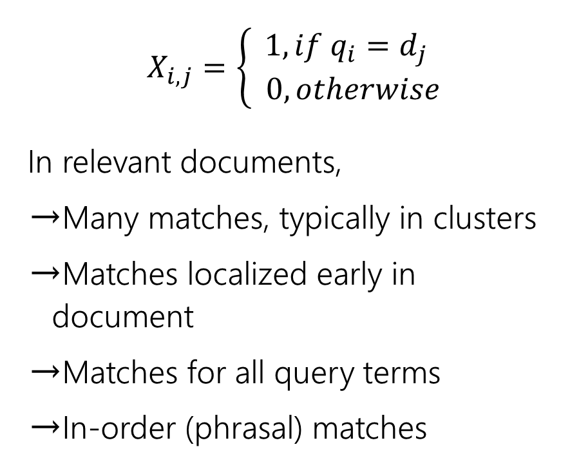
Interaction Matrix of query and document terms
$$X_{i,j}=\left\{\begin{aligned}1, if q_{i}=d_{j} \\ 0, otherwise\end{aligned}\right.$$
In relevant documents,
Many matches, typically in clusters
Matches localized early in document
Matches for all query terms
In-order (phrasal) matches

Slide 38
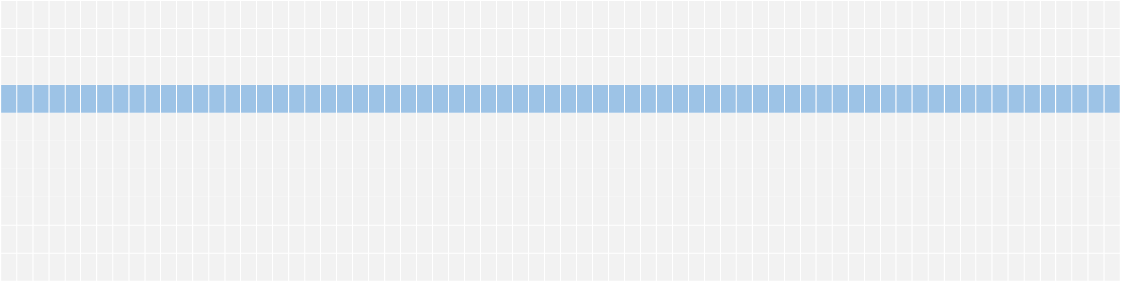
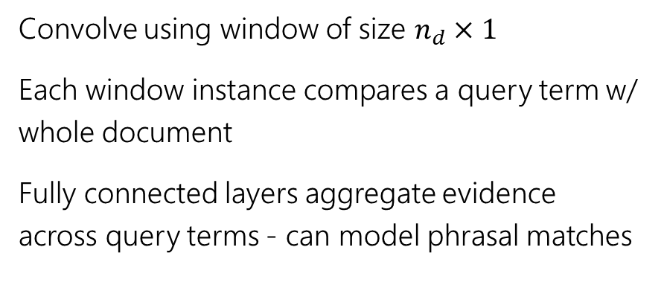
Estimating relevance from interaction matrix
Convolve using window of size $n_{d}×1$
Each window instance compares a query term w/ whole document
Fully connected layers aggregate evidence across query terms - can model phrasal matches
← query words →
← document words →

Slide 39
Local sub-model
Focuses on patterns of exact matches of query terms in document

Slide 40
The Duet architecture
Linear combination of two models trained jointly on labelled query-document pairs
Local model operates on lexical interaction matrix
Distributed model projects n-graph vectors of text into an embedding space and then estimates match

Slide 41
Distributed sub-model
Learns representation of text and matches query with document in the embedding space

Slide 42
Estimating relevance from text embeddings
Convolve over query and document terms
Match query with moving windows over document
Learn text embeddings specifically for the task
Matching happens in embedding space
* Network architecture slightly simplified for visualization – refer paper for exact details
Fully connected
…
Hadamard product
Query embedding
Hadamard product
…
pooling
convolution
…
query
document

Slide 43
Distributed sub-model
Learns representation of text and matches query with document in the embedding space

Slide 44
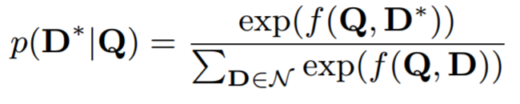
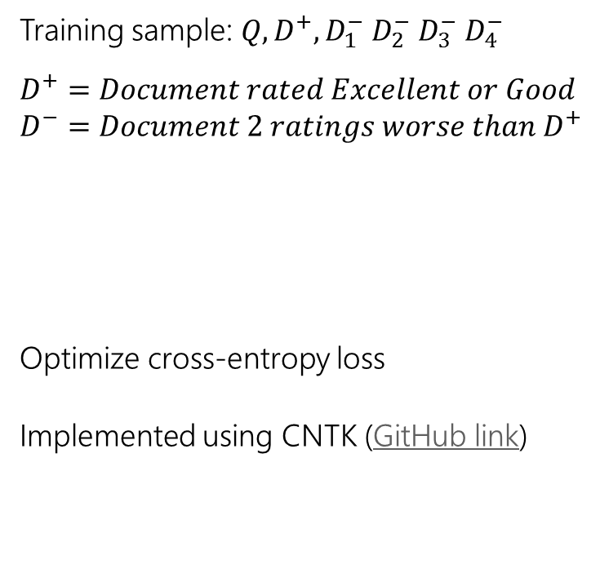
The Duet model
Training sample: $Q, D^{+},D_{1}^{−} D_{2}^{−} D_{3}^{−} D_{4}^{−}$
$$D^{+}=Document rated Excellent or Good$$
$$D^{−}=Document 2 ratings worse than D^{+}$$
Optimize cross-entropy loss
Implemented using CNTK (GitHub link)

Slide 45
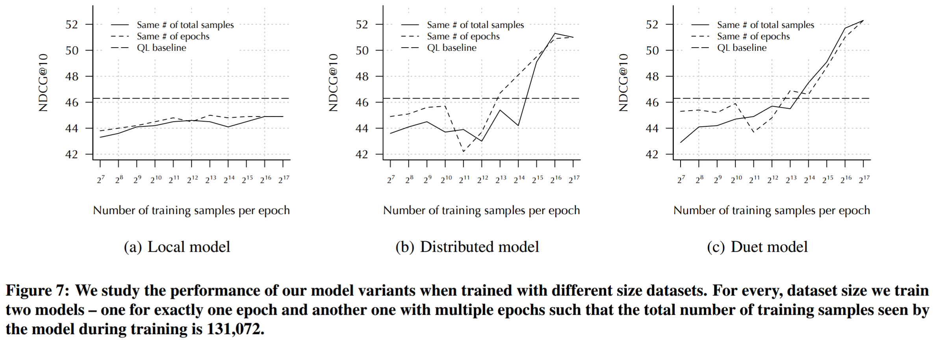
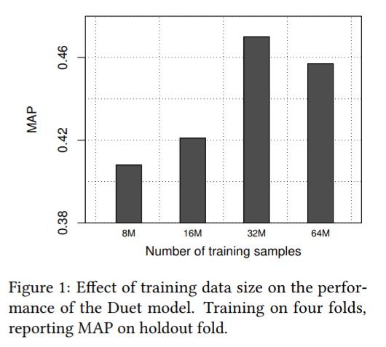
Effect of training data volume
Key finding: large quantity of training data necessary for learning good representations, less impactful for training local model

Slide 46
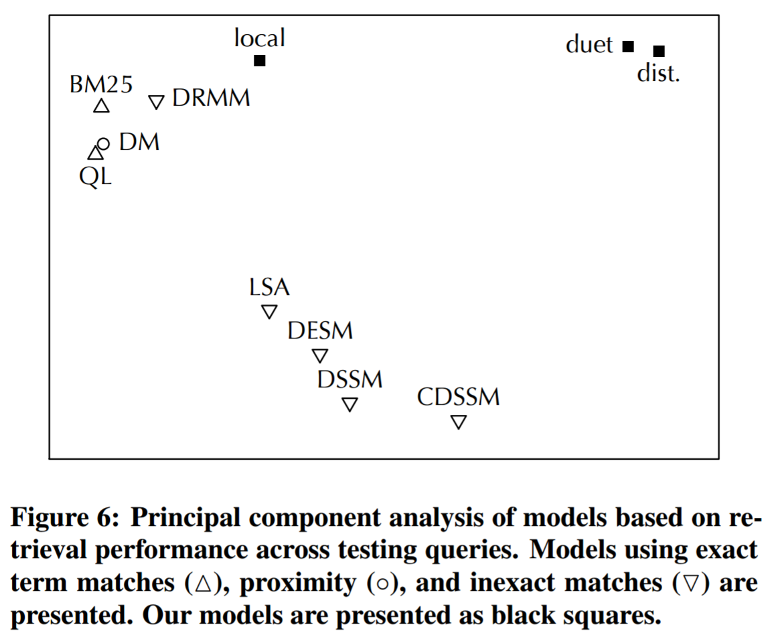
If we classify models by query level performance there is a clear clustering of lexical (local) and semantic (distributed) models

Slide 47
Get the code
Download
Implemented using CNTK python API
https://github.com/bmitra-msft/NDRM/blob/master/notebooks/Duet.ipynb

Slide 48




But Web documents are more than just body text…
URL
body
clicked query
title
incoming anchor text

Slide 49
Extending Neural Ranking Models to Multiple Document Fields
BM25
Neural ranking model
→
→
BM25F
?

Slide 50
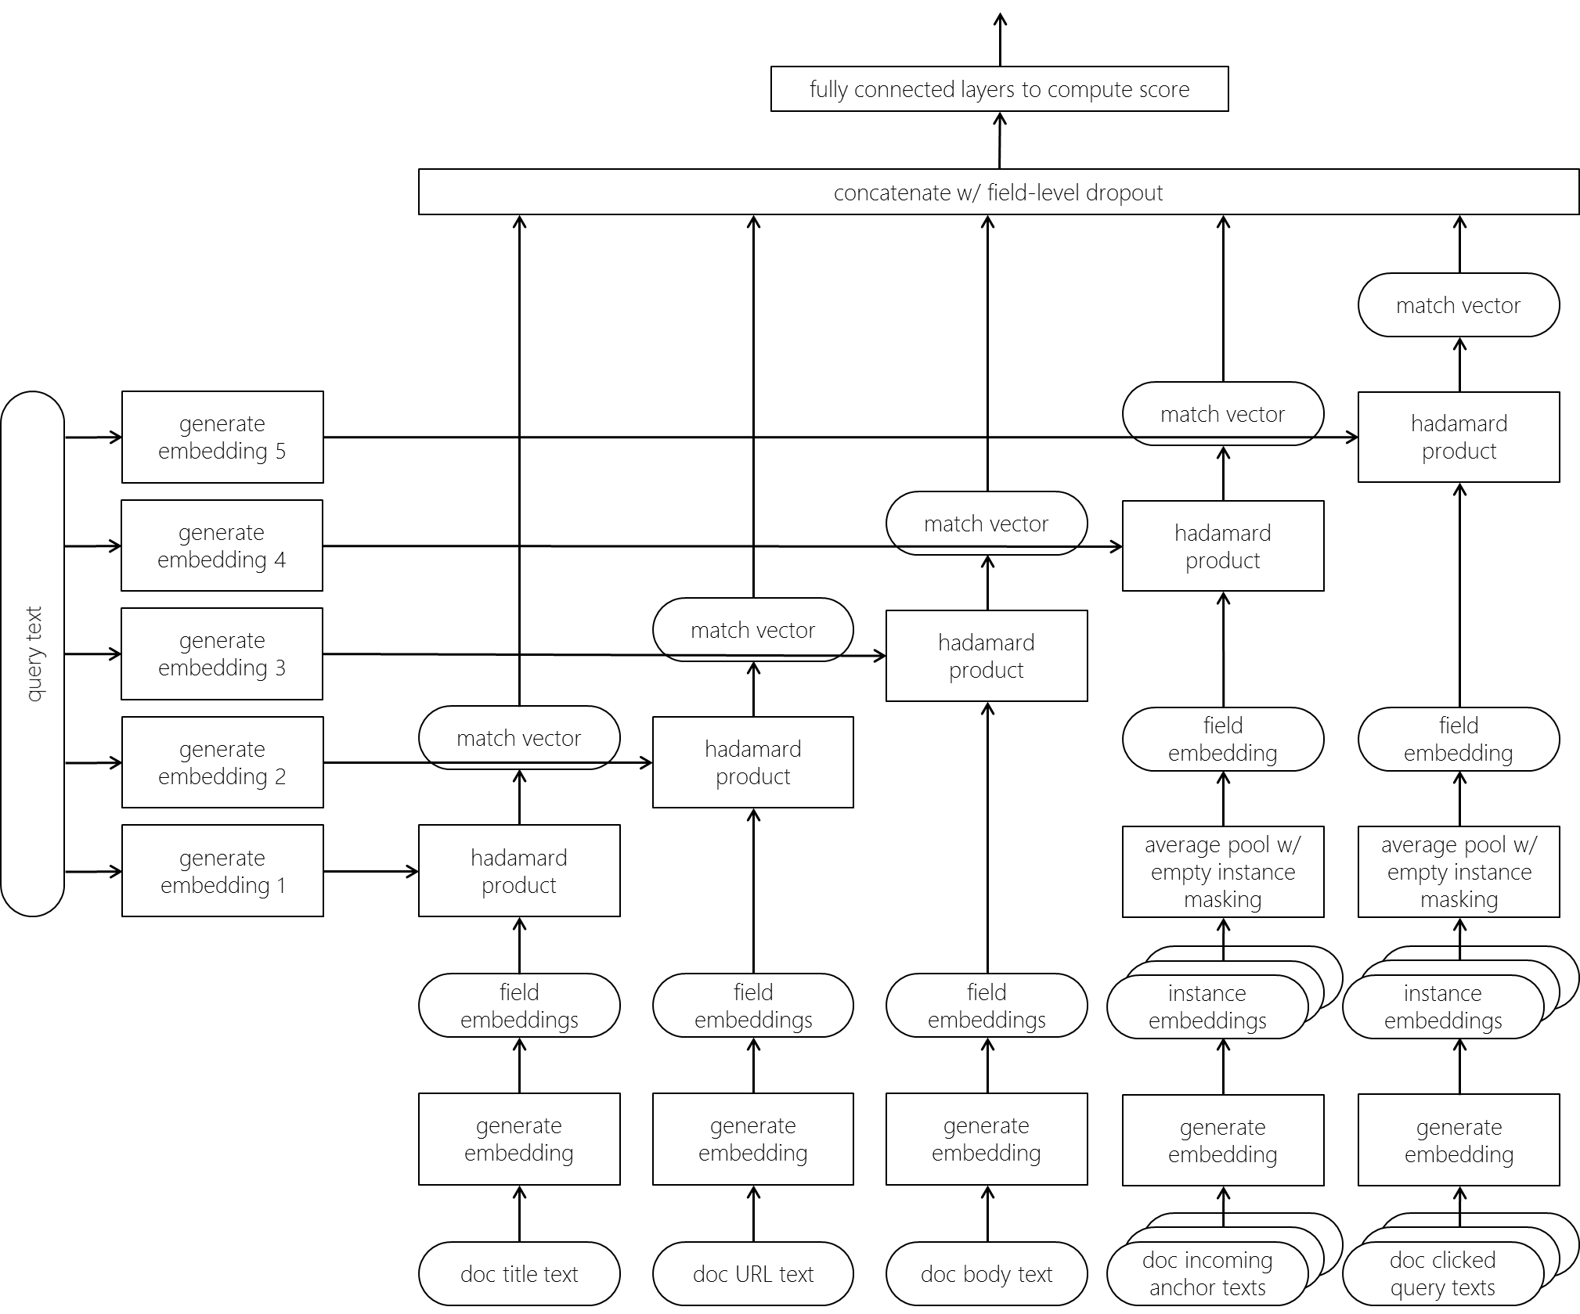
Ranking Documents with multiple fields
Document consists of multiple text fields (e.g., title, URL, body, incoming anchors, and clicked queries)
Fields, such as incoming anchors and clicked queries, contains variable number of short text instances
Body field has long text, whereas clicked queries are typically only few words in length
URL field contains non-natural language text
(Zamani et al., 2018)
https://arxiv.org/abs/1711.09174

Slide 52
Learn a different embedding space for each document field

Slide 53
For multiple-instance fields, average pool the instance level embeddings
Mask empty text instances, and average only among non-empty instances to avoid preferring documents with more instances

Slide 54
Learn different query embeddings for matching against different fields
Different fields may match different aspects of the query
Ideal query representation for matching against URL likely to be different from for matching with title

Slide 55
Represent per field match by a vector, not a score
Allows the model to validate that across the different fields all aspects of the query intent have been covered
(Similar intuition as BM25F)

Slide 56
Aggregate evidence of relevance across all document fields

Slide 57
High precision fields, such as clicked queries, can negatively impact the modeling of the other fields
Field level dropout during training can regularize against over-dependency on any individual field

Slide 58
The design of both Duet and NRM-F models were motivated by long-standing IR insights Deep neural networks have not reduced the importance of core IR research nor the studying and understanding of IR tasks In fact, the same intuitions behind the design of classical IR models were important for feature design in early learning-to-rank models, and now in the architecture design of deep neural networks

Slide 59
Looking forward: proactive retrieval

Slide 60

Reply with: Proactive Recommendation of Email Attachments
For example,
Given the context of the current conversation, the neural model formulates a short text query to pro-actively retrieve relevant attachments that the user may want to include in her response
(Van Gysel et al., 2017)
https://arxiv.org/abs/1710.06061

Slide 61


Summary of papers discussed
An Introduction to Neural Information Retrieval
Bhaskar Mitra and Nick Craswell, in Foundations and Trends® in Information Retrieval, Now Publishers, 2018 (upcoming).
https://www.microsoft.com/en-us/research/wp-content/uploads/2017/06/fntir-neuralir-mitra.pdf
Neural Ranking Models with Multiple Document Fields
Hamed Zamani, Bhaskar Mitra, Xia Song, Nick Craswell, and Saurabh Tiwary, in Proc. WSDM, 2018 (upcoming).
https://arxiv.org/abs/1711.09174
Reply With: Proactive Recommendation of Email Attachments
Christophe Van Gysel, Bhaskar Mitra, Matteo Venanzi, and others, in Proc. CIKM, 2017 (upcoming).
https://arxiv.org/abs/1710.06061
Learning to Match Using Local and Distributed Representations of Text for Web Search
Bhaskar Mitra, Fernando Diaz, and Nick Craswell, in Proc. WWW, 2017.
https://dl.acm.org/citation.cfm?id=3052579
Benchmark for Complex Answer Retrieval
Federico Nanni, Bhaskar Mitra, Matt Magnusson, and Laura Dietz, in Proc. ICTIR, 2017.
https://dl.acm.org/citation.cfm?id=3121099
Query Expansion with Locally-Trained Word Embeddings
Fernando Diaz, Bhaskar Mitra, and Nick Craswell, in Proc. ACL, 2016.
http://anthology.aclweb.org/P/P16/P16-1035.pdf
A Dual Embedding Space Model for Document Ranking
Bhaskar Mitra, Eric Nalisnick, Nick Craswell, and Rich Caruana, arXiv preprint, 2016.
https://arxiv.org/abs/1602.01137
Improving Document Ranking with Dual Word Embeddings
Eric Nalisnick, Bhaskar Mitra, Nick Craswell, and Rich Caruana, in Proc. WWW, 2016.
https://dl.acm.org/citation.cfm?id=2889361
Query Auto-Completion for Rare Prefixes
Bhaskar Mitra and Nick Craswell, in Proc. CIKM, 2015.
https://dl.acm.org/citation.cfm?id=2806599
Exploring Session Context using Distributed Representations of Queries and Reformulations
Bhaskar Mitra, in Proc. SIGIR, 2015.
https://dl.acm.org/citation.cfm?id=2766462.2767702

Slide 62
An introduction to Neural Information Retrieval
Manuscript under review for
Foundations and Trends® in Information Retrieval
Pre-print is available for free download
http://bit.ly/neuralir-intro
(Final manuscript may contain additional content and changes)
Thank You

